Slide 1
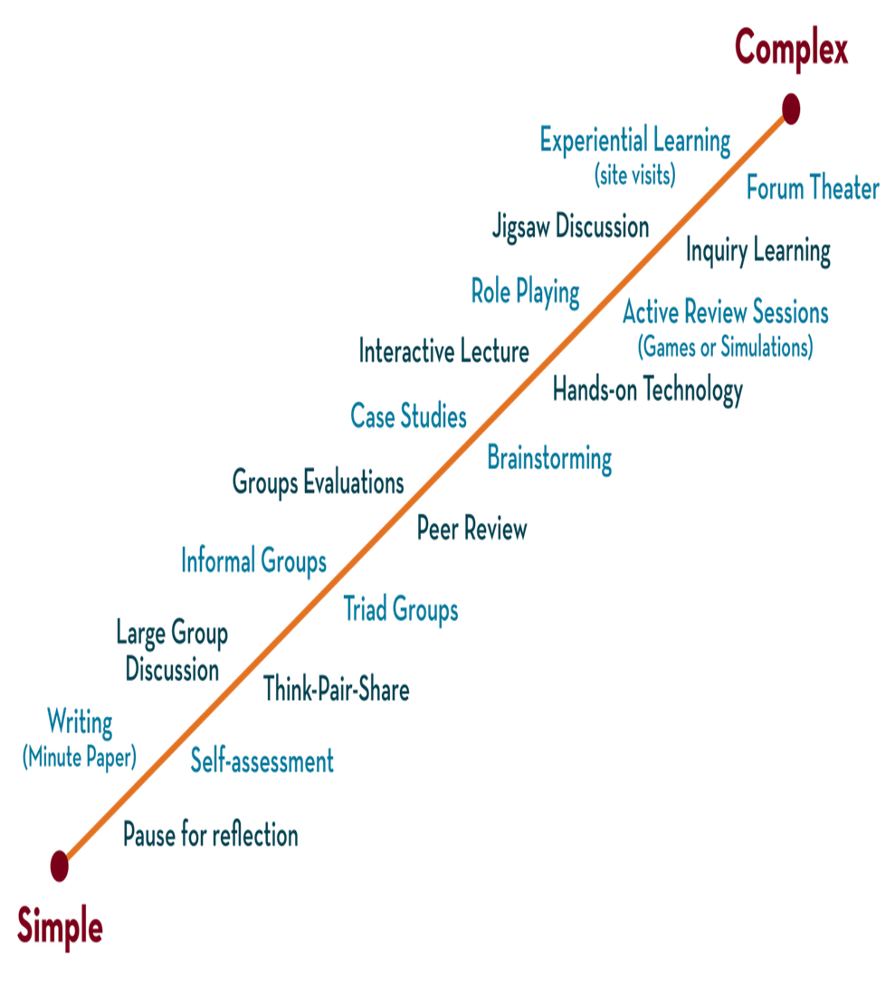

Department of CSE
DESIGN AND ANALYSIS OF ALGORITHMS
24CS2203
Topic:
Divide and Conquer
Strassen’s Matrix Multiplication

Slide 2
Matrix Multiplication
Algorithm: Matrix-Multiplication (X, Y, Z)
for i = 1 to p do
for j = 1 to r do
Z[i,j] := 0
for k = 1 to q do
Z[i,j] := Z[i,j] + X[i,k] × Y[k,j]

Slide 3
Need of the Strassen’s matrix multiplication
Strassen’s matrix multiplication follows Divide and Conquer Strategy.
By using the Strassen’s Matrix multiplication algorithm, the time consumption can be improved a little bit when compared to the basic matrix multiplication.
Strassen’s Matrix multiplication can be performed only on square matrices where n is a power of 2. Order of both of the matrices are n × n.

Slide 4
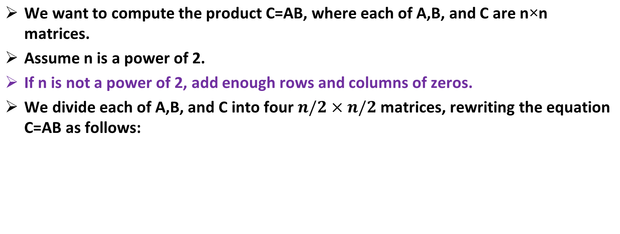

Divide and Conquer Technique

Slide 5
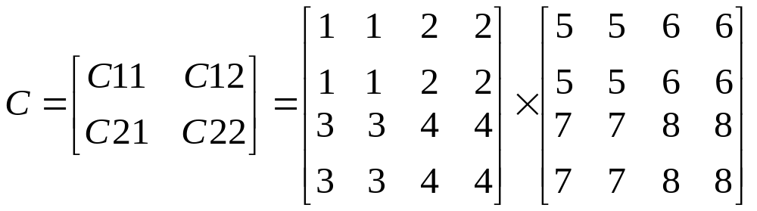
A₁₁
A₁₂
B₁₁
B₁₂
c₁₁
c₁₂
Then,
C₁₁=A₁₁B₁₁+A₁₂B₂₁
C₁₂=A₁₁B₁₂+A₁₂B₂₂
C₂₁=A₂₁B₁₁+A₂₂B₂₁
C₂₂=A₂₁B₁₂+A₂₂B₂₂
Each of these four equations specifies two multiplications of n/2×n/2 matrices and the addition of their n/2×n/2 products.
We can derive the following recurrence relation:
T(n)= 1 if n=1
8T(n/2)+ 4n² if n>1
c₂₁
c₂₂
A₂₁
A₂₂
B₂₁
B₂₂

Slide 6
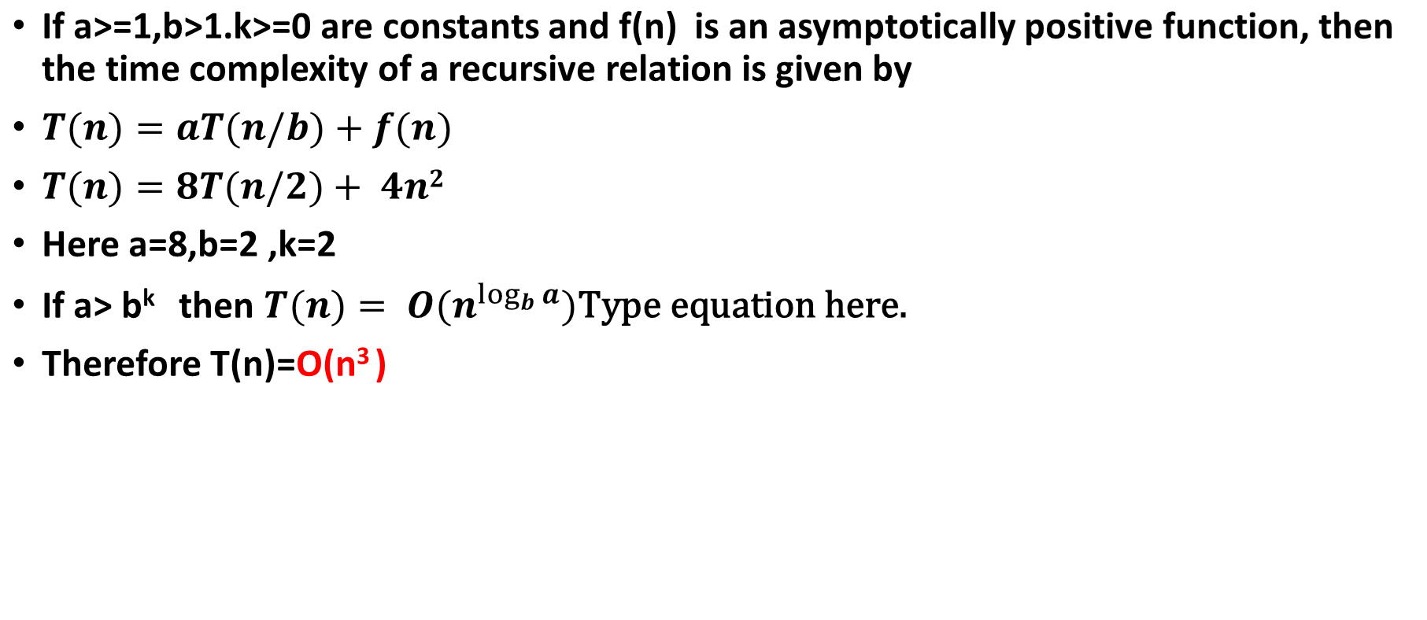
Master Theorem

Slide 7
Strassen’s method
Matrix multiplications are more expensive than matrix additions or subtractions ( O(n³) versus O(n²)).
Strassen’s has discovered a way to compute the multiplication using only 7 multiplications and 18 additions or subtractions.

Slide 8
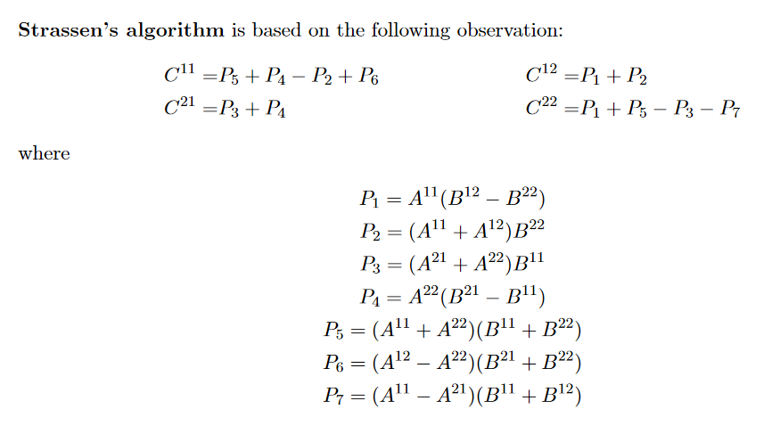
Strassen’s Formulae
T(n)= 1 if n=1
7T(n/2)+ 18n² if n>1

Slide 9
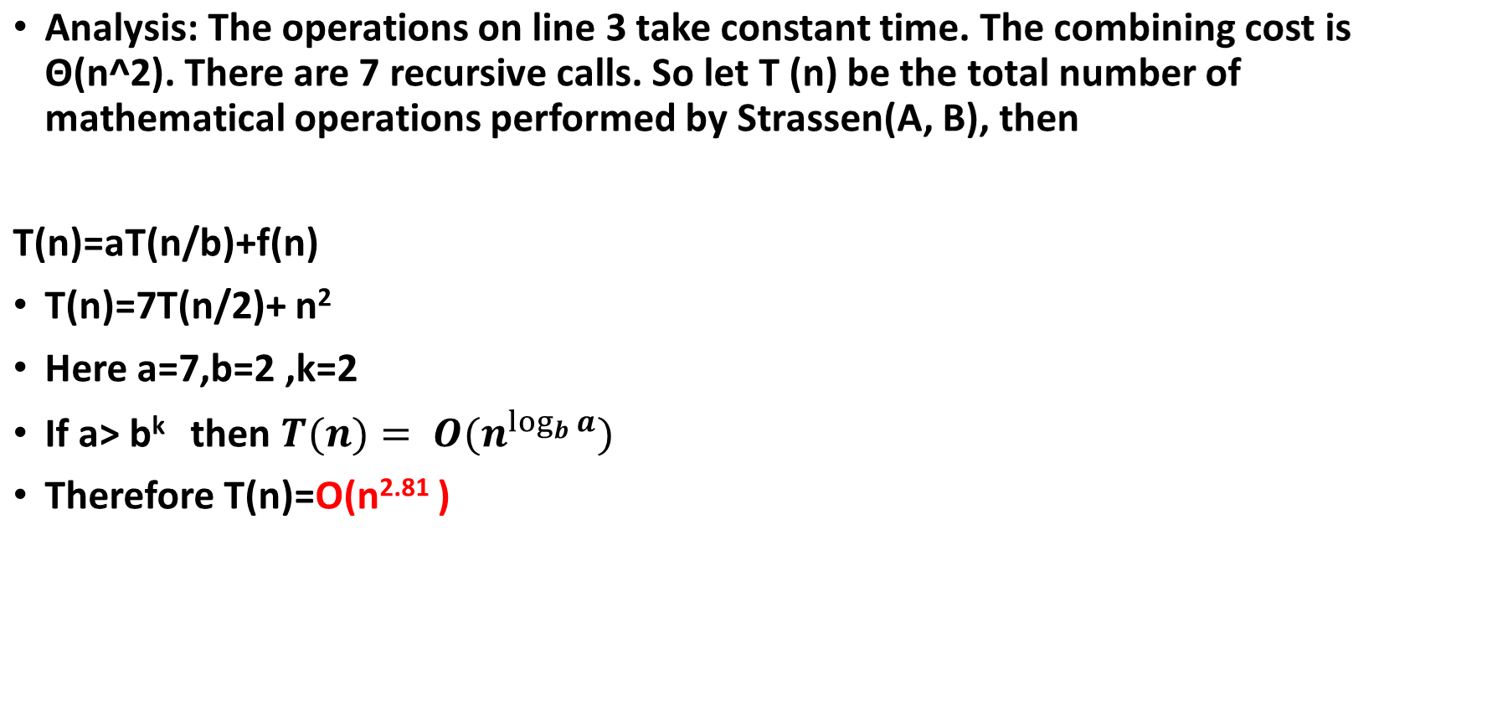


Slide 10
Conclusion
The number 2.81 may not seem much smaller than 3, but because the difference is in the exponent, the impact on running time is significant.
In fact, Strassen’s algorithm beats the ordinary algorithm on today’s machines.
 | Mult | Add | Recurrence Relation | Runtime
Regular | 8 | 4 | T(n) = 8T(n/2) + O(n²) | O(n³)
Strassen‘s | 7 | 18 | T(n) = 7T(n/2) + O(n²) | O(n ^{log27}) = O(n^{2.81})
≥

Slide 11
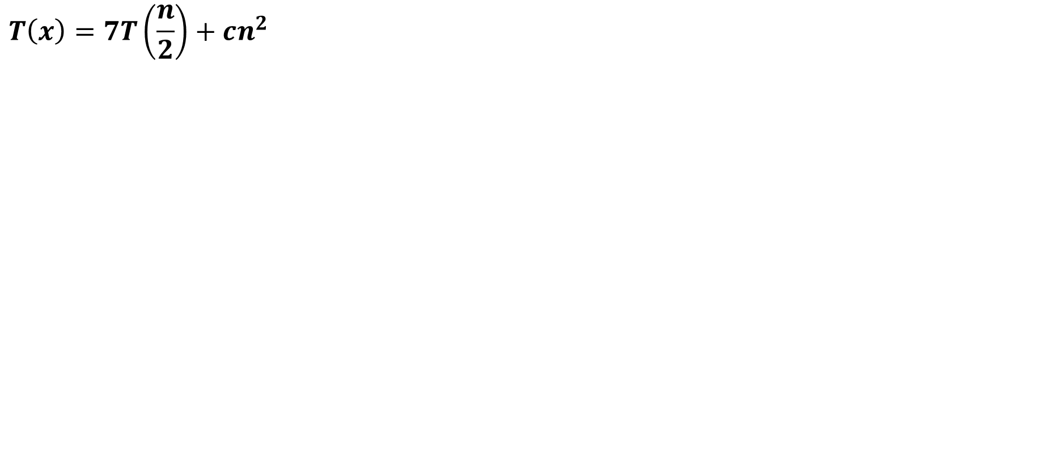

Time complexity

Slide 12
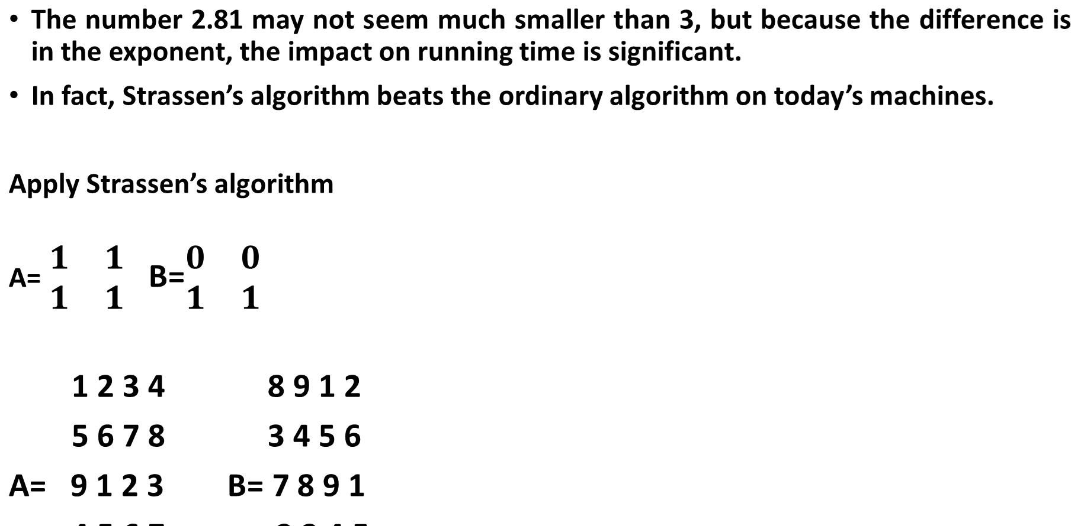
Example

